Slide 1

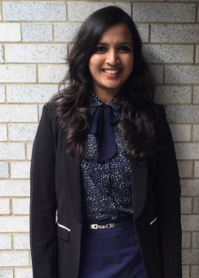
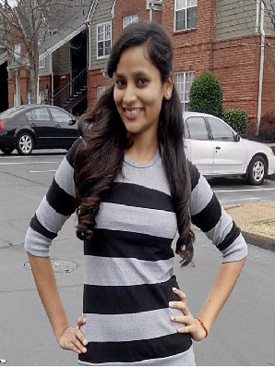
Hotel Recommendation http://hoteladvisorsystem.azurewebsites.net/
Team 3
Amitha
Divyansh
Jyoti

Slide 2
Problem Statement
Expedia has provided us logs of customer behavior. These include what customers searched for, how they interacted with search results (click/book), whether or not the search result was a travel package.
Our goal is to predict the booking outcome (hotel cluster) for a user event, based on their search and other attributes associated with that user event.
Recommending hotels to users based on hotel properties and user behavior.
Sentimental analysis of the reviews given by the user.

Slide 3
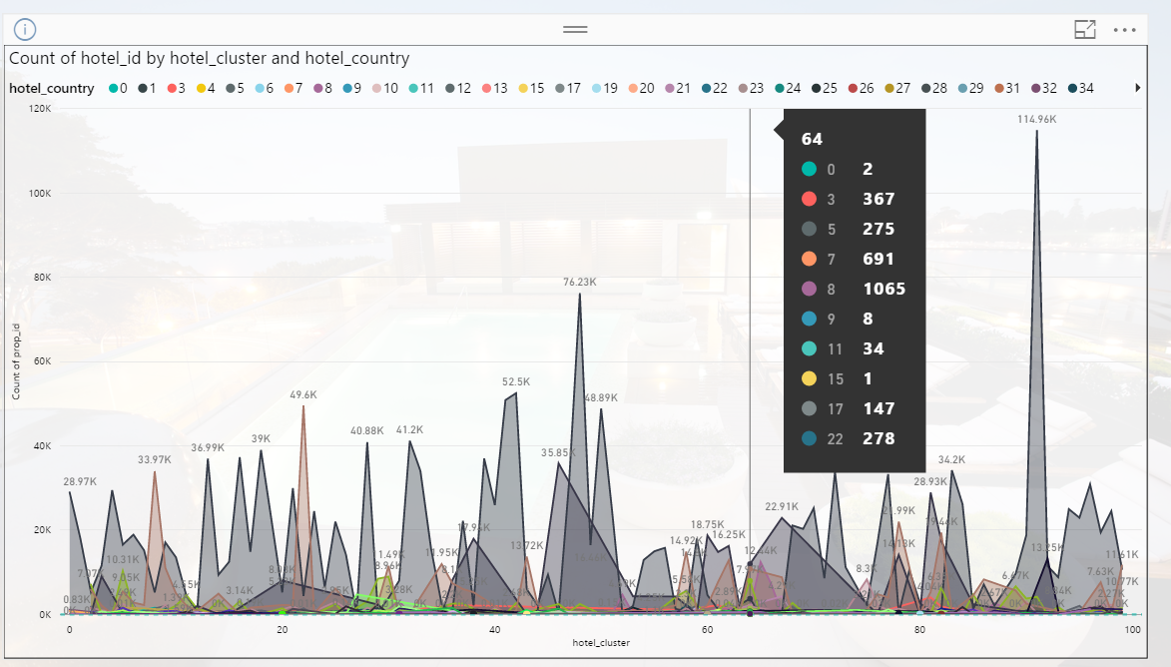
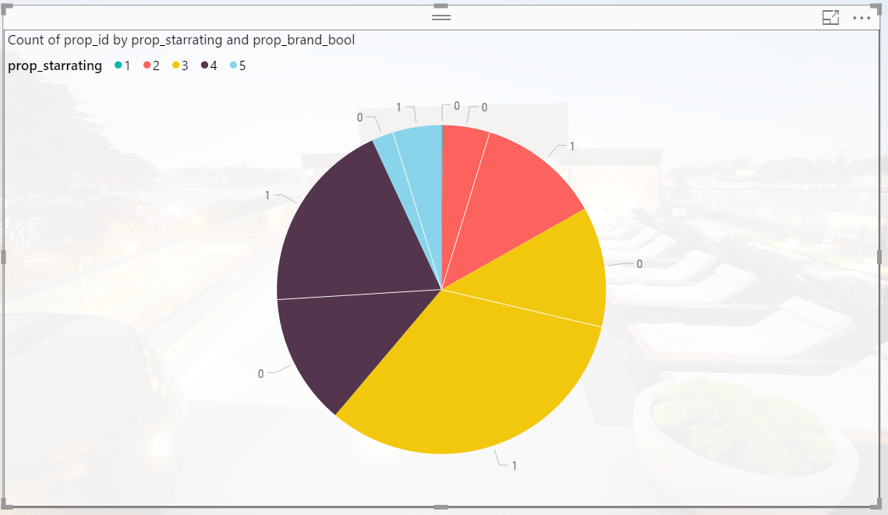
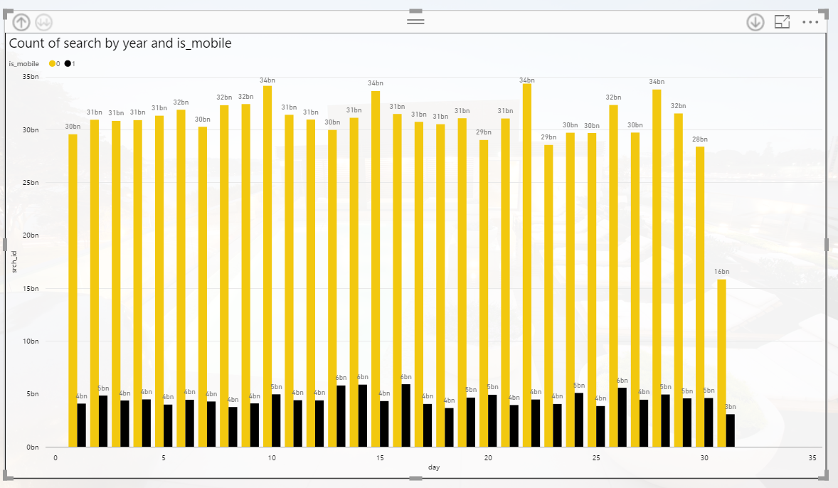
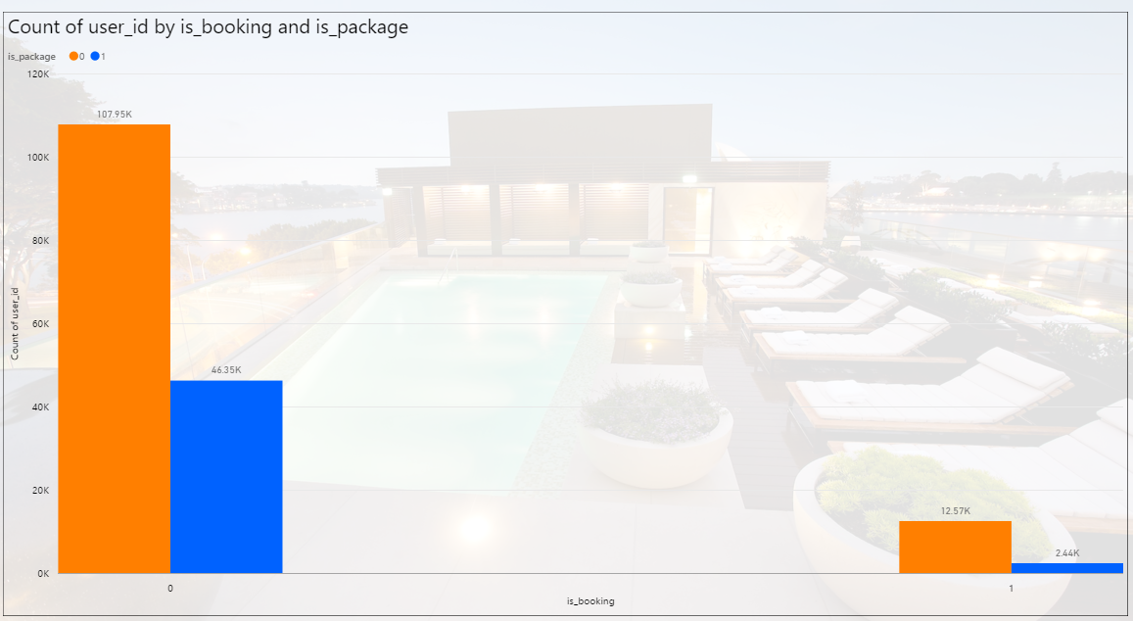
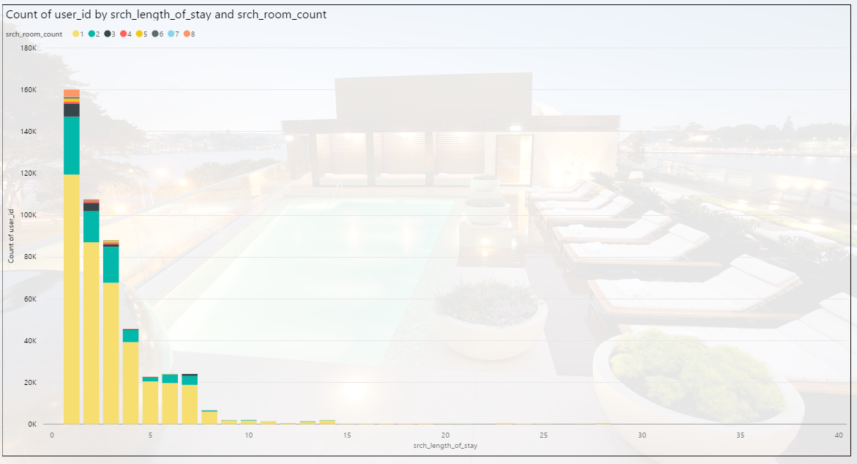
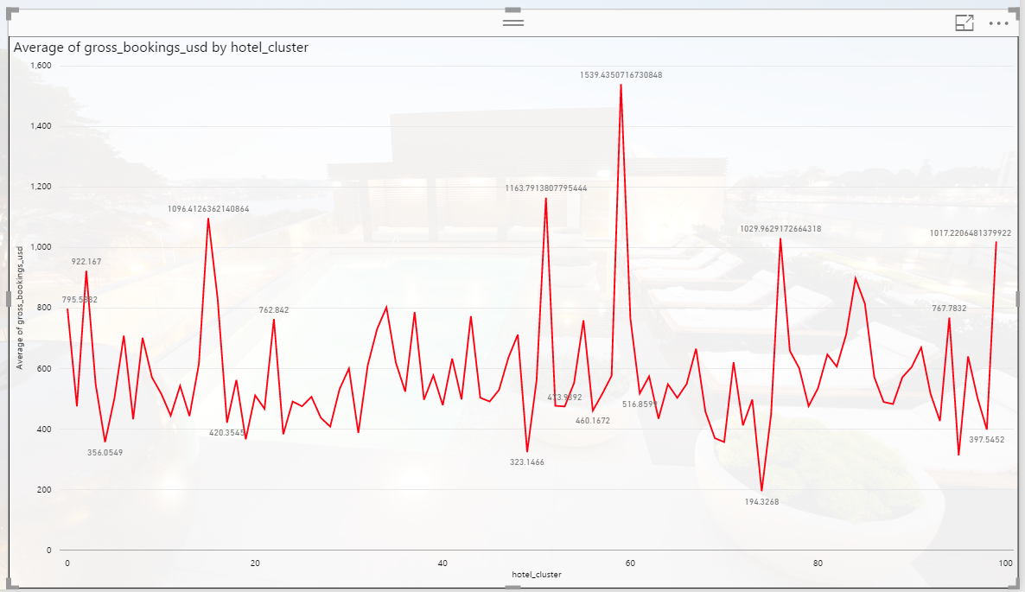
Data Visualization Power BI

Slide 4
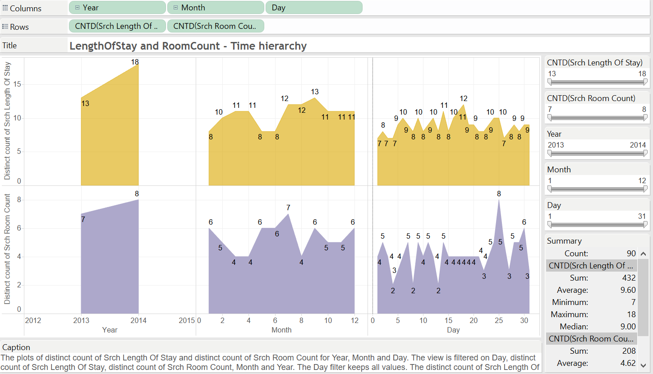
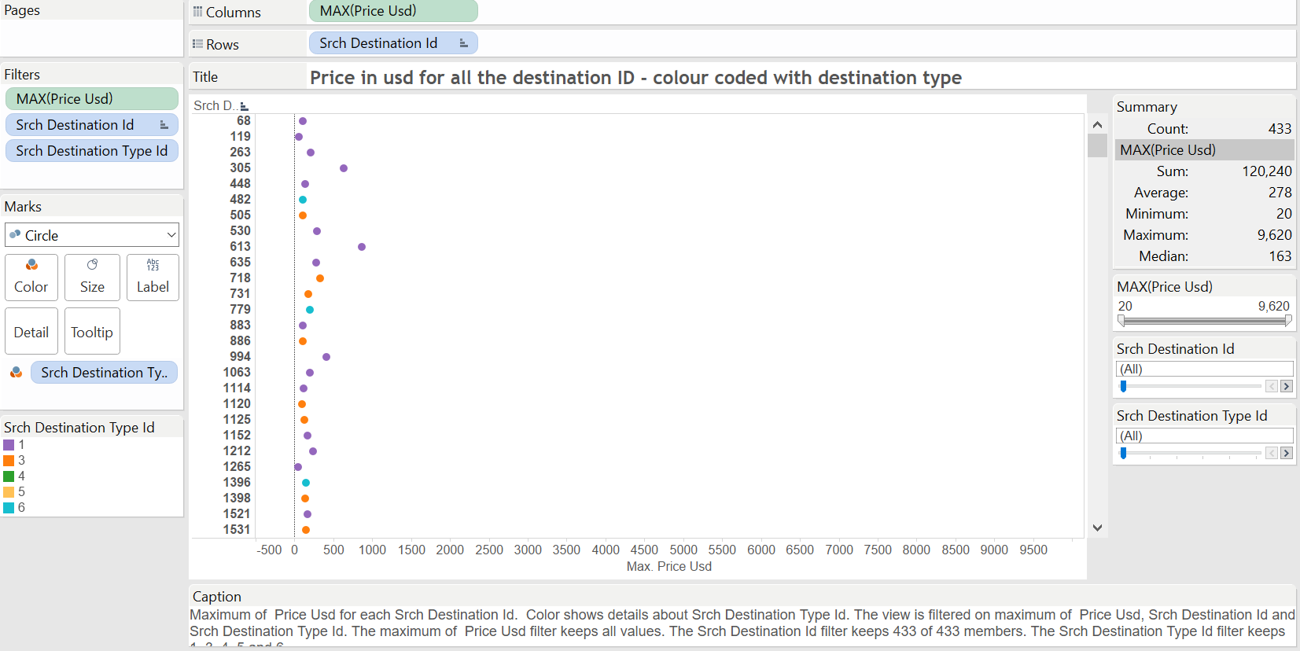
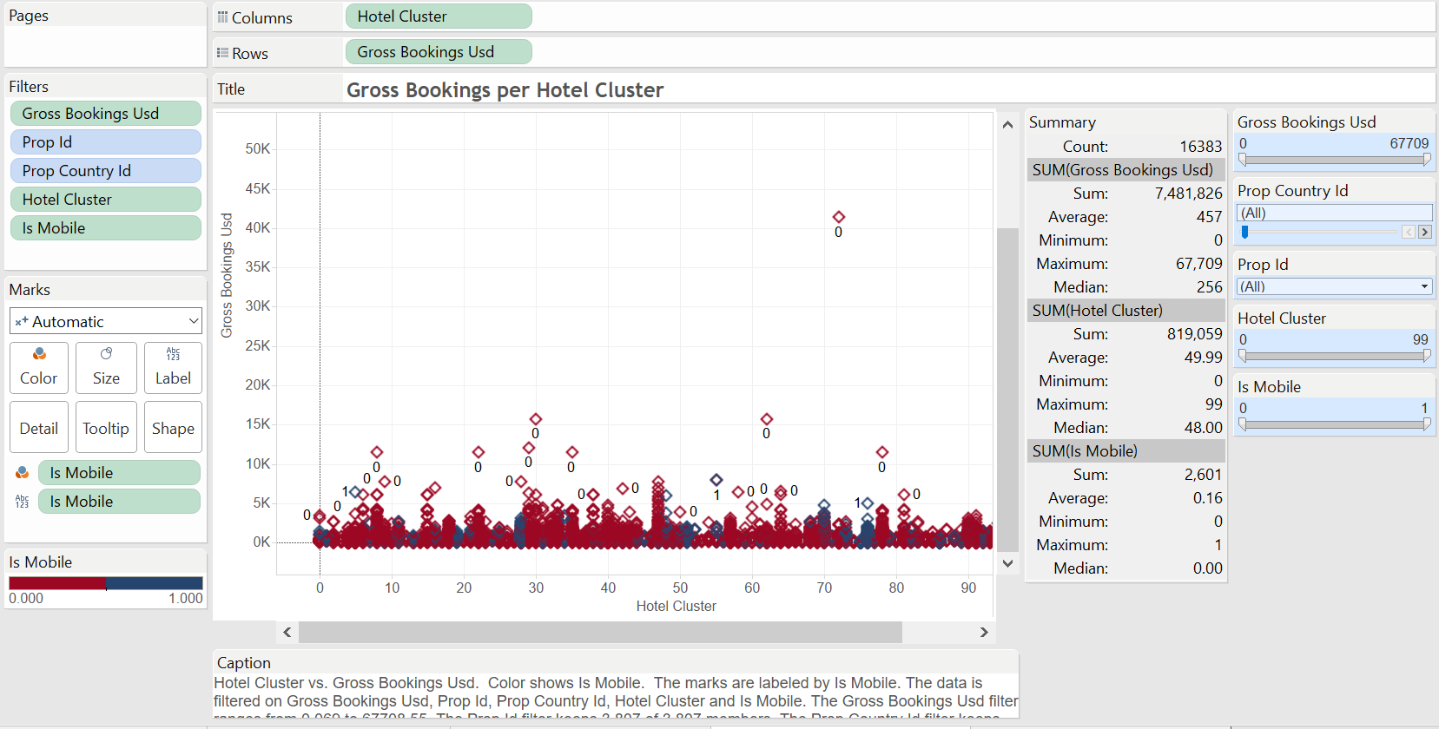
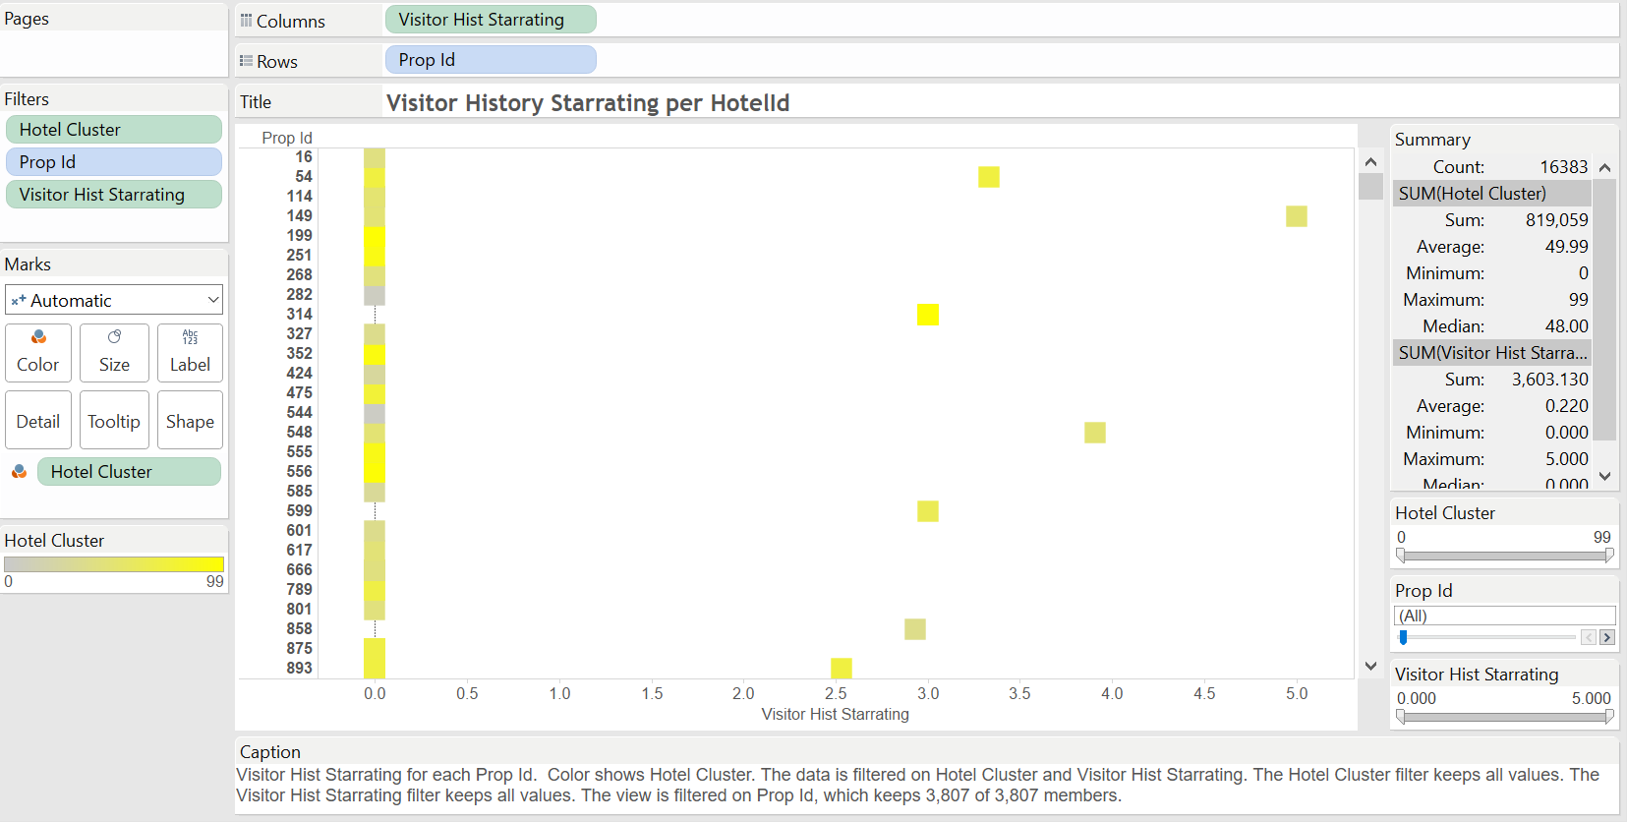
Data Visualization Tableau

Slide 5
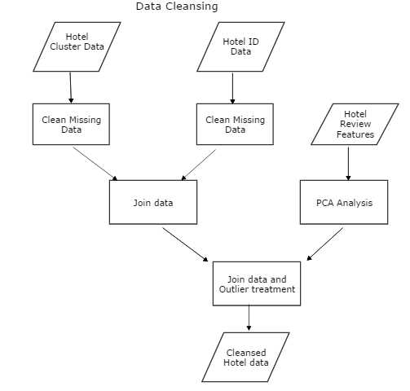
Data Pre-Processing
Missing data treatment
Feature Engineering
Feature selection
Outlier removal

Slide 6
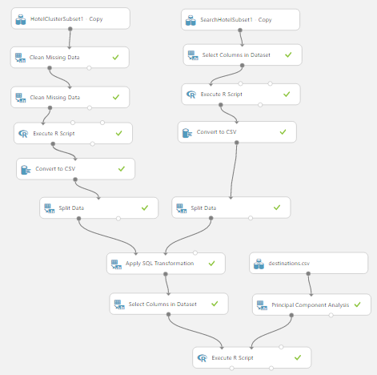

Slide 7
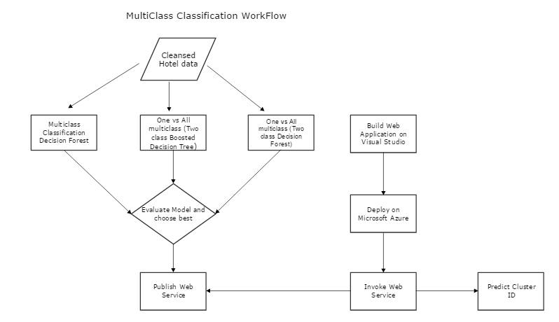
Classification

Slide 8
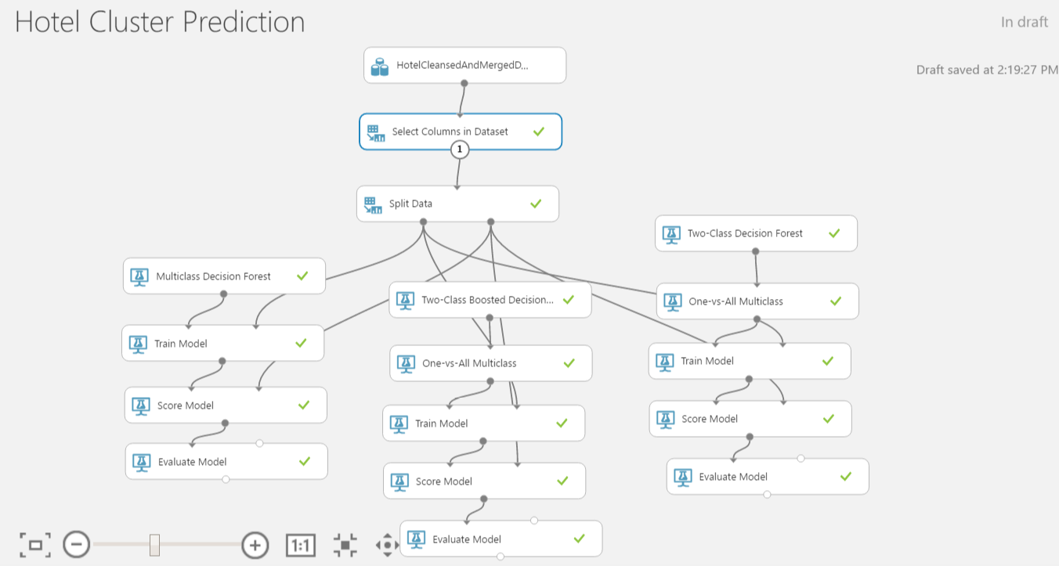

Slide 9
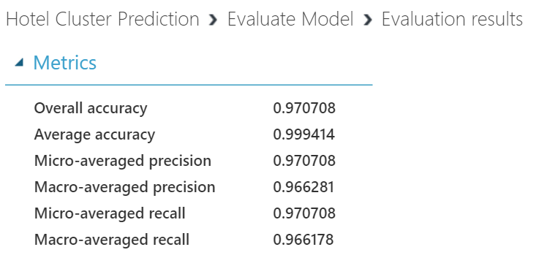
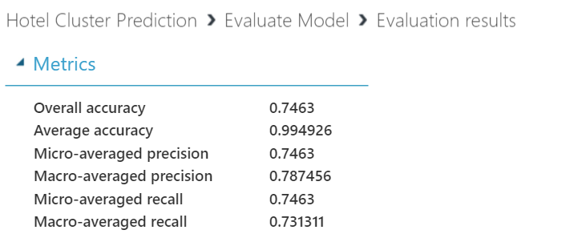
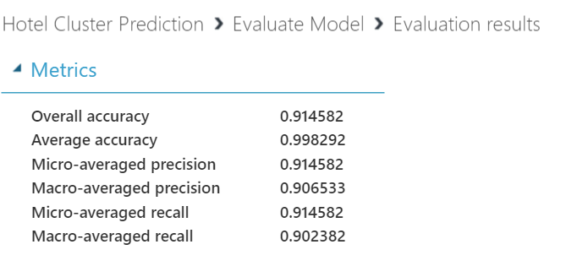
Classification Model | Metrics
Multiclass Decision Forest
One – vs – All Multiclass (Two class Boosted Decision Tree)
One – vs – All Multiclass (Two class Decision Forest)

Slide 10
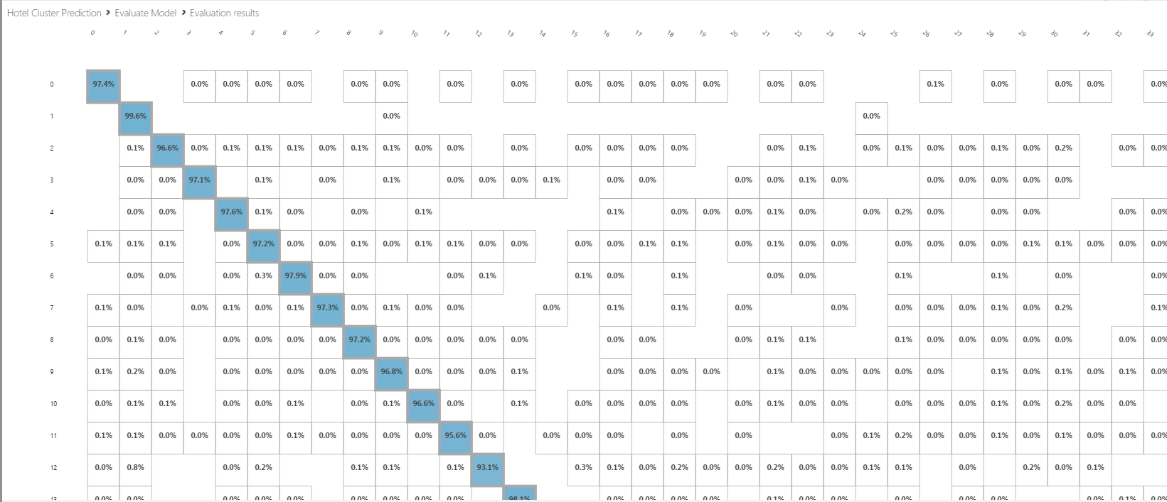
Multiclass Decision Forest

Slide 11
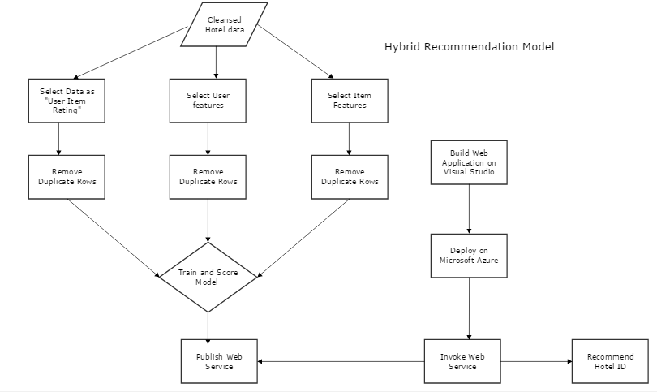
Recommendation System

Slide 12
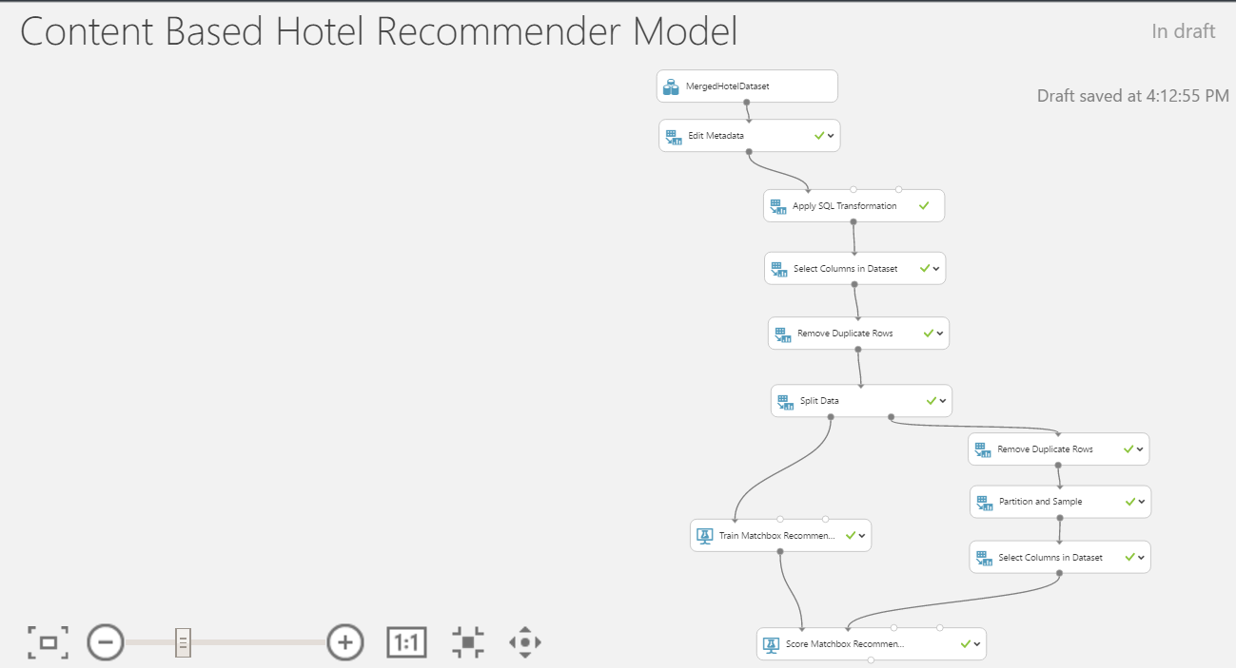

Slide 13
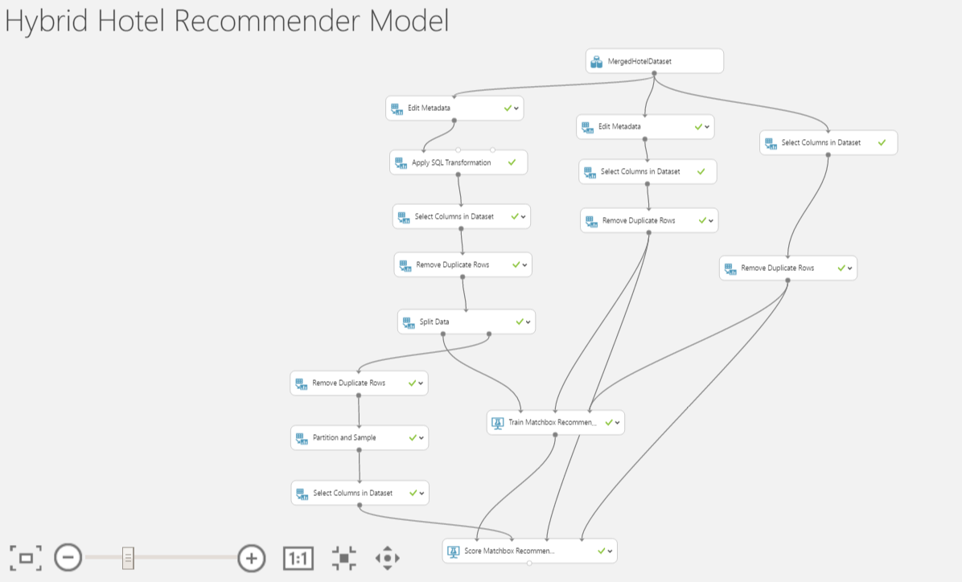

Slide 14
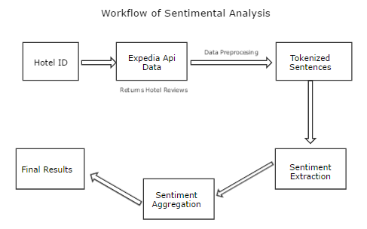
Sentiment Analysis

Slide 15
Thank You

